Slide 1

CAPSTONE PROJECT 3
CARDIOVASCULAR RISK
PREDICTION
Presented by:
SANA MULANI

Slide 2
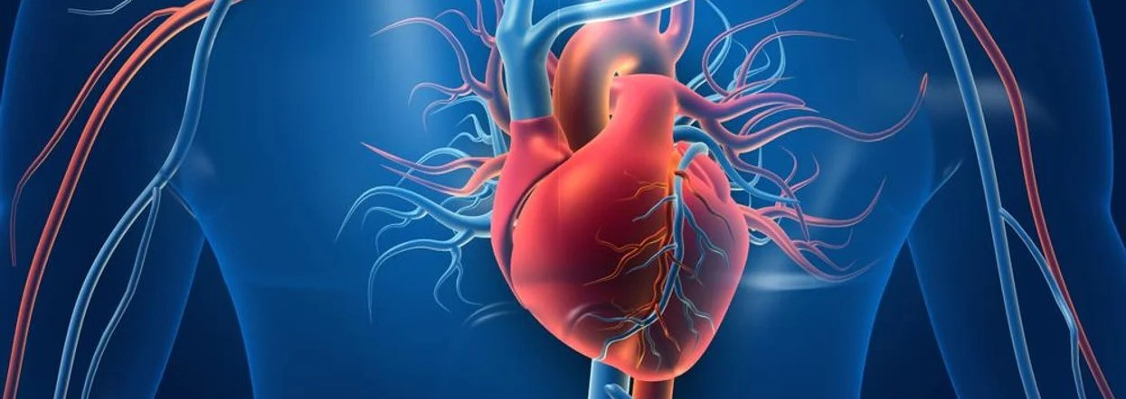
PROBLEM STATMENT:
The dataset is from an ongoing cardiovascular study on residents of the town of Framingham, Massachusetts.
The classification goal is to predict whether the patient has a 10-year risk of future coronary heart disease (CHD).
The dataset provides the patients’ information. It includes over 4,000 records and 15 attributes. Each attribute is a potential risk factor. There are both demographic, behavioral, and medical risk factors.

Slide 3
DATA DESCRIPTION
Demographic:
Sex: male or female("M" or "F")
Age: Age of the patient;(Continuous - Although the recorded ages have been truncated to whole numbers, the concept of age is continuous)
Behavioral:
is_smoking: whether or not the patient is a current smoker ("YES" or "NO")
Cigs Per Day: the number of cigarettes that the person smoked on average in one day.(can be considered continuous as one can have any number of cigarettes, even half a cigarette.)
Medical( history):
BP Meds: whether or not the patient was on blood pressure medication (Nominal)
Prevalent Stroke: whether or not the patient had previously had a stroke (Nominal)
Prevalent Hyp: whether or not the patient was hypertensive (Nominal)
Diabetes: whether or not the patient had diabetes (Nominal)

Slide 4
DATA DESCRIPTION
Medical( current):
Tot Chol: total cholesterol level (Continuous)
Sys BP: systolic blood pressure (Continuous)
Dia BP: diastolic blood pressure (Continuous)
BMI: Body Mass Index (Continuous)
Heart Rate: heart rate (Continuous - In medical research, variables such as heart rate though infact discrete, yet are considered continuous because of large number of possible values.)
Glucose: glucose level (Continuous)
Predict variable (desired target):
10-year risk of coronary heart disease CHD(binary: “1”, means “Yes”, “0” means “No”) -DV

Slide 5
IMPORTING AND INSPECTING DATASET
Used following libraries: NumPy, pandas, seaborn, matplotlib, sklearn, XGboost, imblearn and statsmodule.
The shape of the dataframe is (3390, 17) i.e. 3390 records and 17 columns.
Dropping the id column because it just contains unique id number for each patient and will not be used for prediction.
Missing value count and percent in each column are as follows:
glucose-304 (8.97%)
education-87 (2.57%)
BPMeds-44 (1.30%)
totChol-38 (1.12%)
cigsPerDay - 22 (0.65%)
BMI-14 (0.41%)
heartRate-1 (0.03% )
Replacing the NaN values with median, in all the columns.

Slide 6
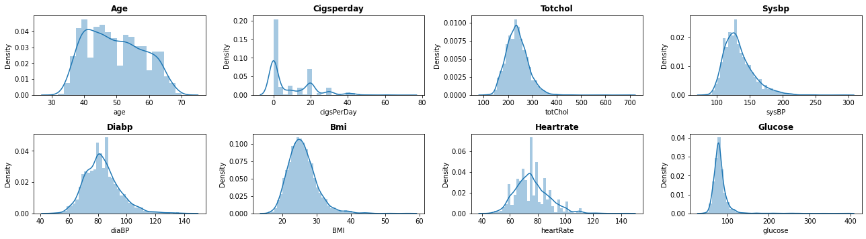
VISUALIZING DISTRIBUTIONS

Slide 7
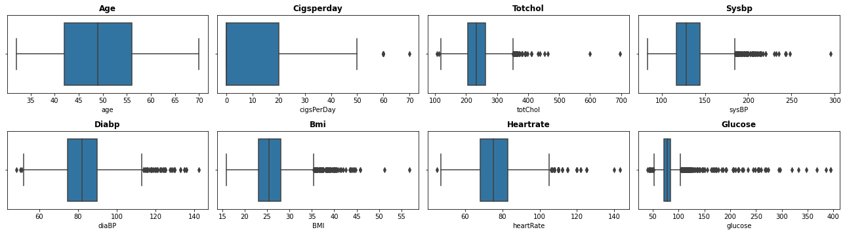
CHECKING OUTLIERS
We can clearly see outliers in some columns. We treated it by replacing them with the median values.

Slide 8
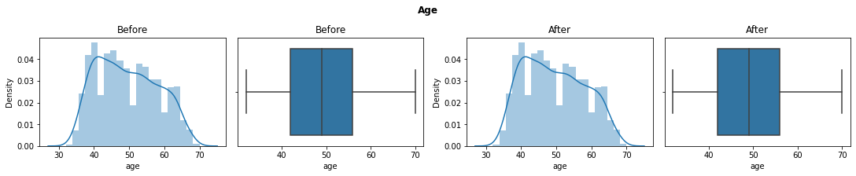
HANDLING OUTLIERS
IQR method of identifying outliers is to set up a "fence" outside of Q1 and Q3. Any values that fall outside of this fence are considered outliers.
The IQR is then the difference between Third quartile and First quartile. To build this fence we take 1.5 times the IQR and then subtract this value from Q1 and add this value to Q3. This gives us the minimum and maximum fence posts that we compare each observation to.
Any observations that are more than 1.5 IQR below Q1 or more than 1.5 IQR above Q3 are considered outliers. we replaced the outliers and with median values i.e. 50th percentile of that column.
Lets visualize the plots of each feature before and after the outlier treatment.

Slide 9
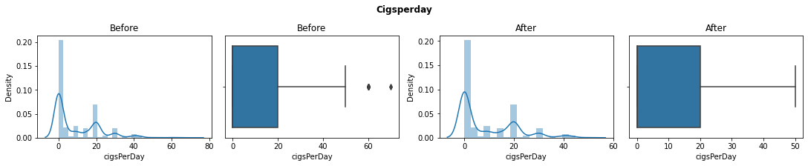
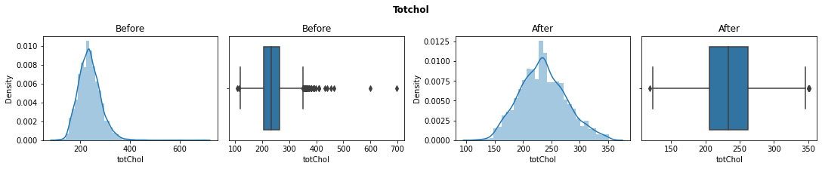
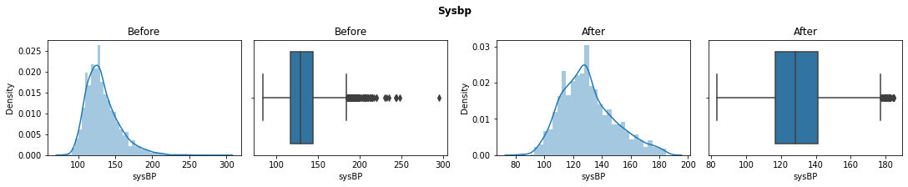

Slide 10
CLEANING AND MANIPULATING THE DATA
Checking for the duplicates values in the datasets, showed there are no duplicate records in the dataframe.
Checking unique value with their counts in categorical features to define an encoder in order to replace those values with numeric values.
Replaced "M" with 1 and "F" with 0 in the sex column.
Replaced "YES" with 1 and "NO" with 0 in the is_smoking column.

Slide 11
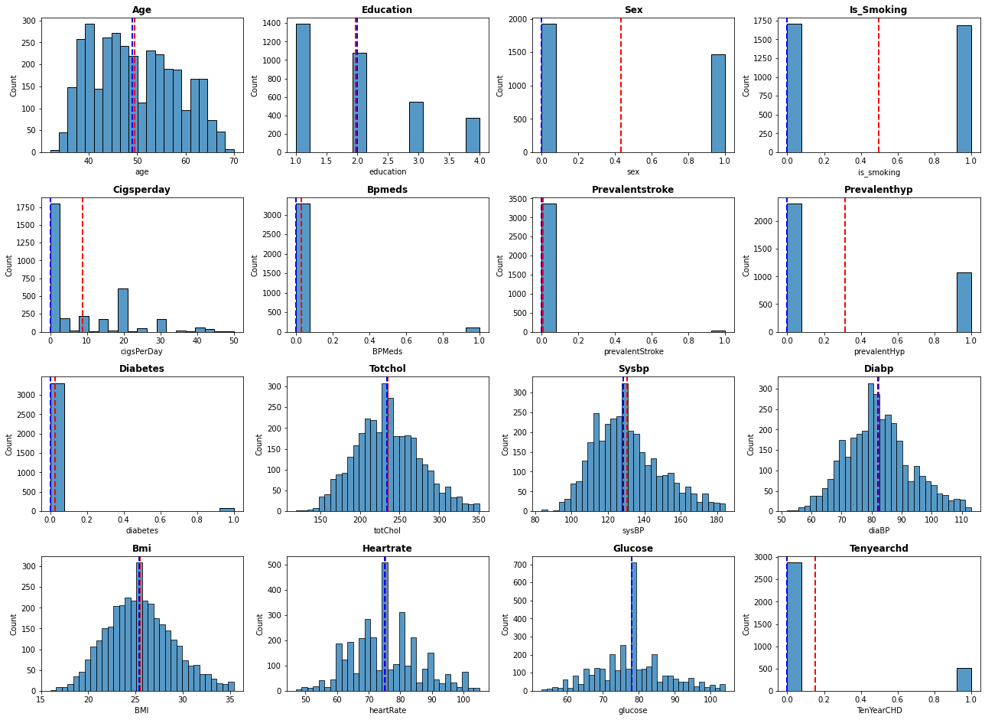
UNIVARIATE ANALYSIS
Univariate analysis is to understand the distribution of values for a single variable. It is used to describe the every single feature. Measure of central tendency means where the mean or median of the dataset is located, measure of dispersion represent how spread out the values are in the datasets including std deviation and variance. Red and blue lines in the plot represent the mean and median respectively.

Slide 12
UNIVARIATE ANALYSIS

Slide 13
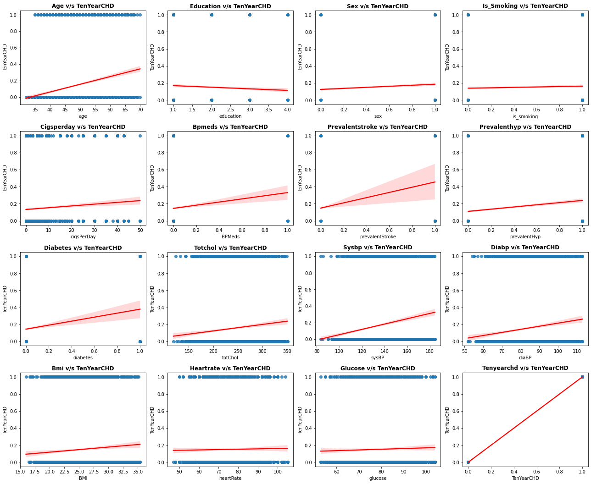
BIVARIATE ANALYSIS
In Bivariate analysis we are visualizing the relation between dependent variable and rest of the independent variable.

Slide 14
BIVARIATE ANALYSIS
From the plots we can see that age, bmi, totchol, sysbp, diabp etc. are having a clear cut positive relation with the dependent variable, whereas rest of the features have nominal association.

Slide 15
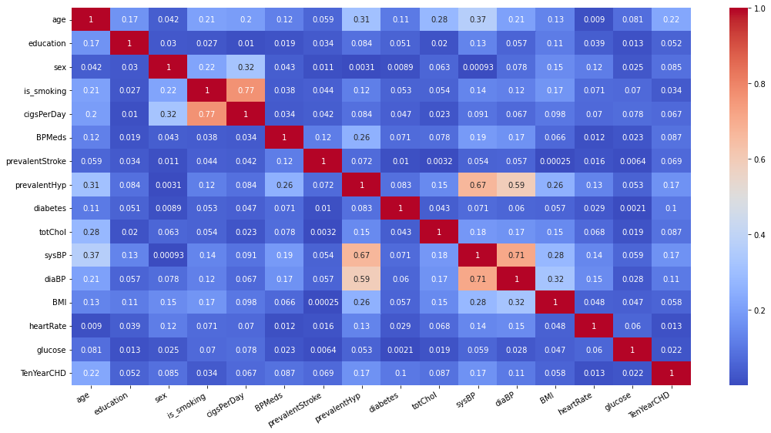
MULTIVARIATE ANALYSIS

Slide 16
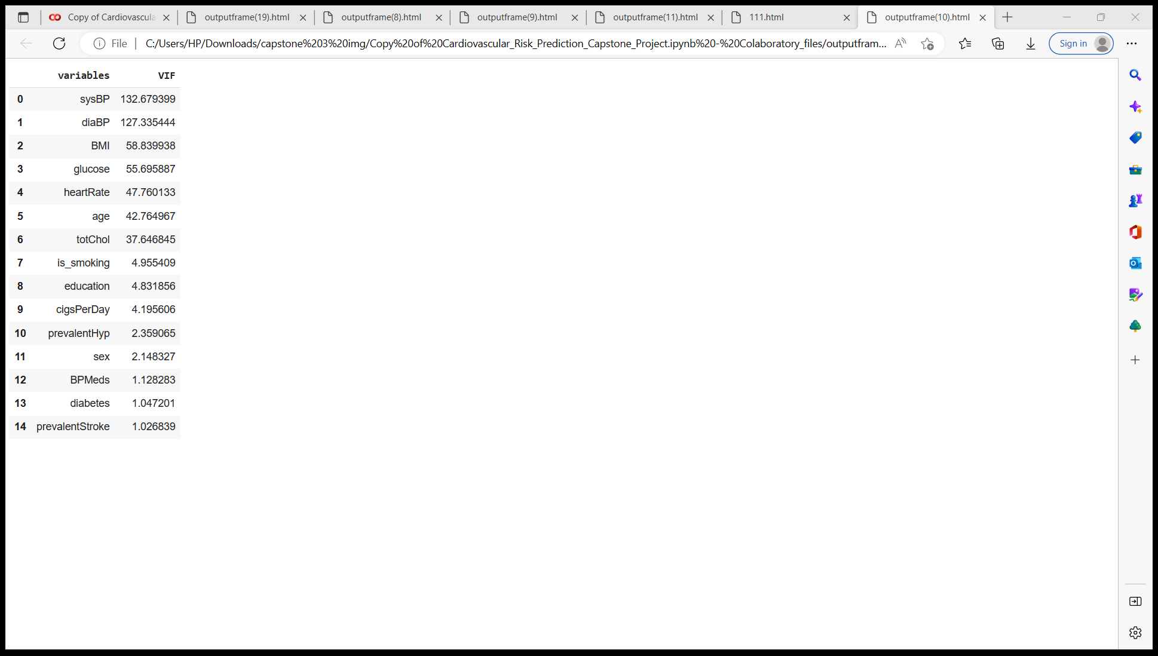
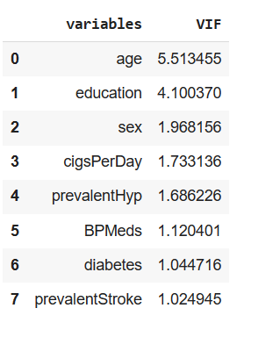
MULTICOLLINEARITY ANALYSIS
Checking the multicollinearity between all the features, there are some features which are highly correlated with each other like is_smoking and cigsperday and so on.
To handle the multicollinearity we have used VIF score of all independent variable which represents how well the variable is explained by other independent variables.
we have excluded the features whose VIF score is higher than 10. Pictures in the left and right shows the VIF scores of variables before and after multicollinearity treatment.

Slide 17
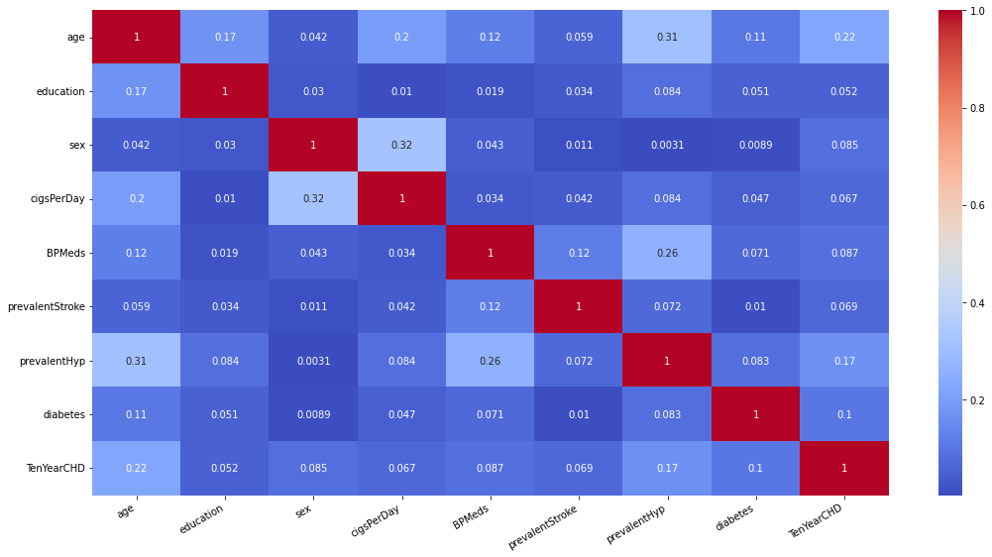
UPDATED HEATMAP

Slide 18
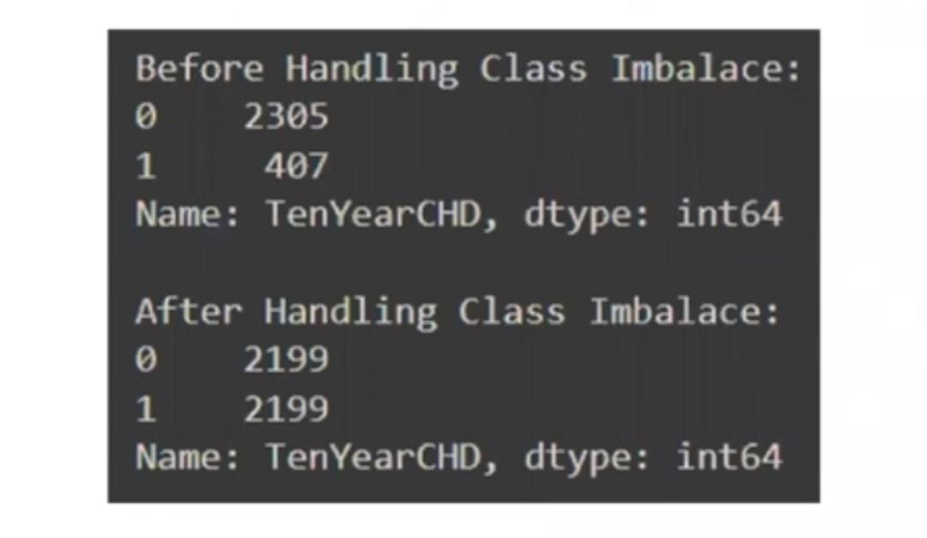
MODEL BUILDING PREREQUISITES
• Using Minmax scaler for scaling the features.
• Making a variable to define F1 score of class 1 of the target variable so as to use it at the time of hyperparameter tuning because by default Gridsearch will maximize the Macro Average of F1 score for all classes. However we want to maximize the F1 score of class 1.
• Defining X and Y variables, and splitting the data in 80-20 ratio as train and test sets.
Handling class imbalance by oversampling using SMOTE followed by removing the Tomek links. Finally Checking value counts for both classes Before and After handling Class Imbalance.
Defining a function which takes classifier model and train test splits as input and outputs the classification report for model performance on train and test data. Also plots the feature importance.

Slide 19
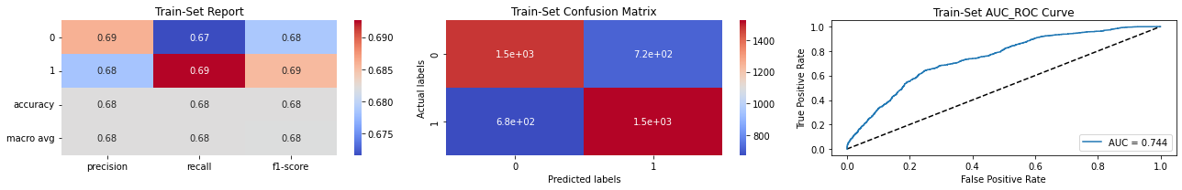
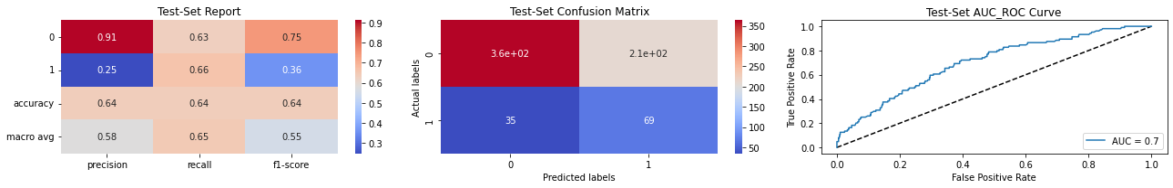
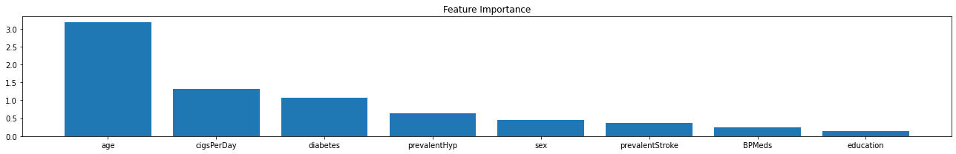
LOGISTIC REGRESSION

Slide 20
LOGISTIC REGRESSION
• Starting with the quick and dirty models first, then proceeding towards the complex models. Logistic regression outputs following result for class 1 on test data:
• Precision -0.25*
• Recall -0.66
F1 Score-0.36
The feature importance plotted is based on the beta coefficients of z (i.e. before applying sigmoid function).
• Age is the most influencing feature, followed by CigsPerDay followed by diabetes.

Slide 21
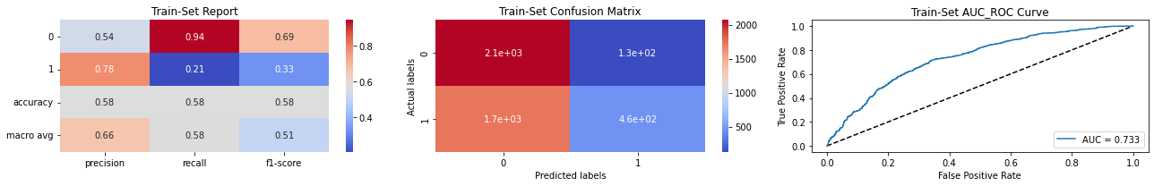
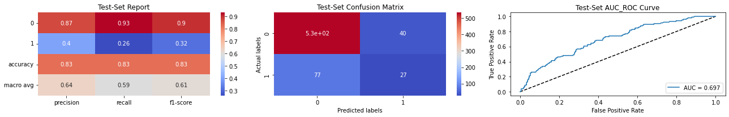
NAÏVE BAYES CLASSIFIER
• Naïve Bayes Classifier is very fast to implement and may be used as a baseline model to compare with different models. It outputs following result for class 1 on test data:
Precision -0.4
Recall -0.26
F1 Score-0.32

Slide 22
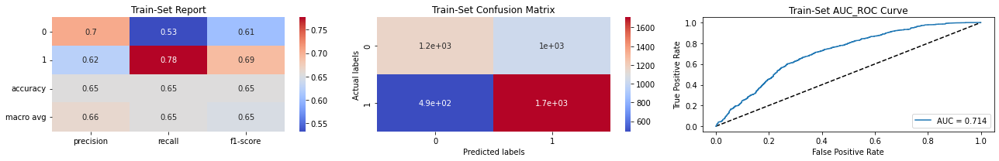
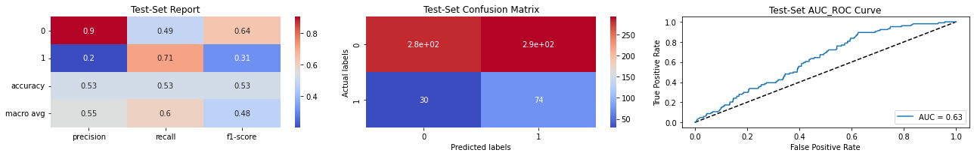
SUPPORT VECTOR CLASSIFIER
Support Vector Classifier with C=0.1 outputs following result for class 1 on test data:
• Precision -0.2
• Recall -0.71
• F1 Score - 0.31

Slide 23
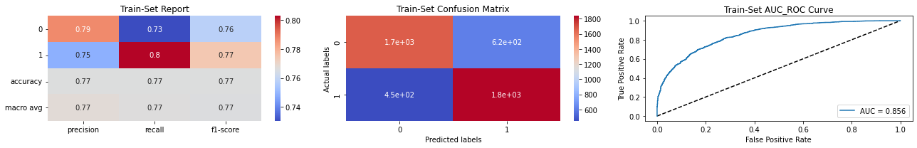
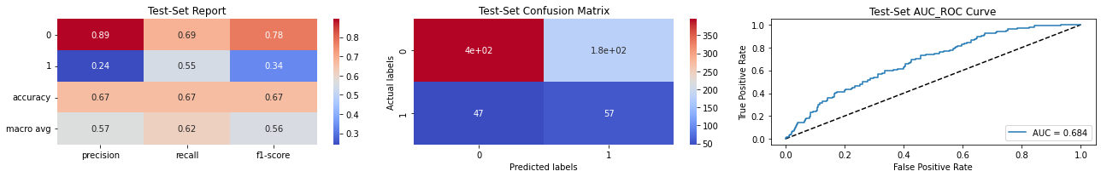
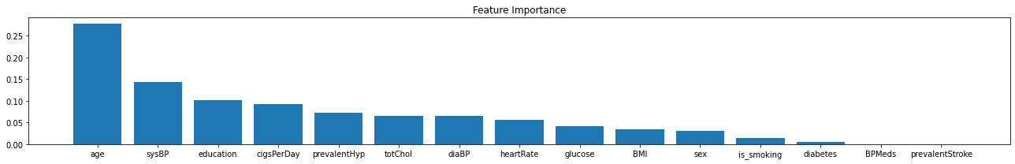
RANDOM FOREST CLASSIFIER

Slide 24
RANDOM FOREST CLASSIFIER
RandomForestClassifier(max_depth-8, min_samples_leaf-46, min_samples_split-50) gives following result for class 1 on test data:
• Precision-0.24
• Recall -0.55
F1 Score - 0.34
• Age followed by sysBP appear to be the feature with high global importance for most of the trees in the RandomForest Ensemble.

Slide 25
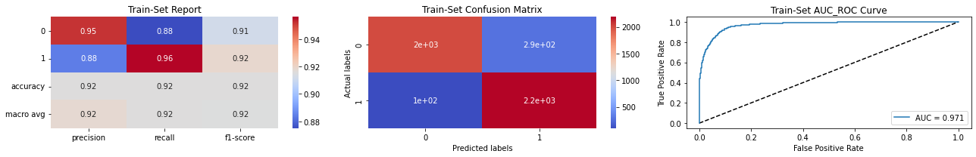
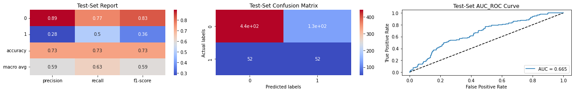
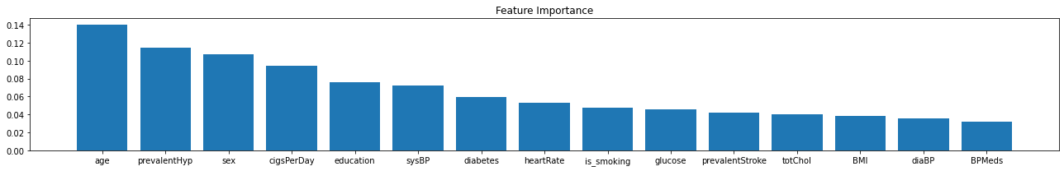
XGBOOST REGRESSOR

Slide 26
XGBOOST REGRESSOR
XGBRFClassifier(eta=0.05, max_depth=10, min_samples_leaf-30, min_samples_split-50, n_estimators=150) gives following result for class 1 on test data:
• Precision -0.28
• Recall -0.5
F1 Score-0.36
Age and prevalentHyp appear to be the feature with high global importance for most of the trees in the XGBoost tree Ensemble.

Slide 27
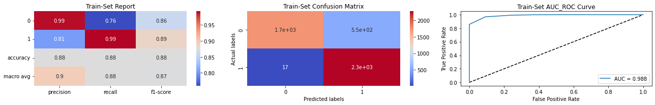
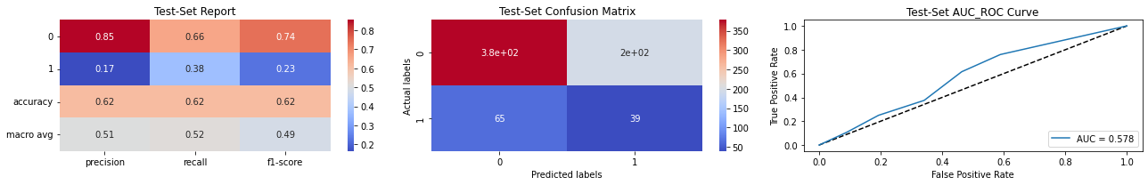
KNN CLASSIFIER
KNeighborsClassifier(metric='manhattan', 'n_neighbors=5) gives following result for class 1 on test data:
Precision -0.17
Recall -0.38
F1 Score-0.23

Slide 28
CONCLUSION
If we want to completely avoid any situations where the patient has heart disease, a high recall is desired. Whereas if we want to avoid treating a patient with no heart diseases a high precision is desired.
Assuming that in our case the patients who were incorrectly classified as suffering from heart disease are equally important since they could be indicative of some other ailment, so we want a balance between precision and recall and a high f1 score is desired.
Since we have added synthetic datapoints to handle the huge class imbalance in training set, the data distribution in train and test are different so the high performance of models in the train set is due to the train-test data distribution mismatch and not due to overfitting.
Best performance of Models on test data based on evaluation metrics for class 1:
Recall - SVC
Precision - Naive Bayes Classifier
F1 Score - Logistic Regression, XGBoost
Accuracy - Naive Bayes Classifier

